Slide 1
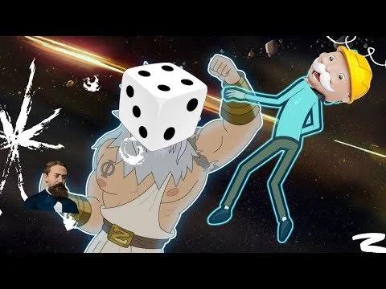
Applications of Markov Chain in games
Group no. 07
Systematic squad
Nikita Rahi-28
Asma Shaikh-05
Pallavi Sawant-32
Vedant Bhalekar-52
Pradnya More-34
Shubham Upadhyay-30
Amruta Bandopadhyay-22

Slide 2
Introduction of Markov chains
Markov chains are fundamental part of stochastic process.
The basic idea were developed by the Russian mathematician A.A. Markov.
A Markov chain is a random process with the property that the Next state only depends on current state.
In mathematical terms, the definition can be expressed as follows:
A stochastic process X = {Xn , n ε N} in a countable space S is a discrete-time Markov chain if:
For all n ≥ 0, Xn ε S

Slide 3
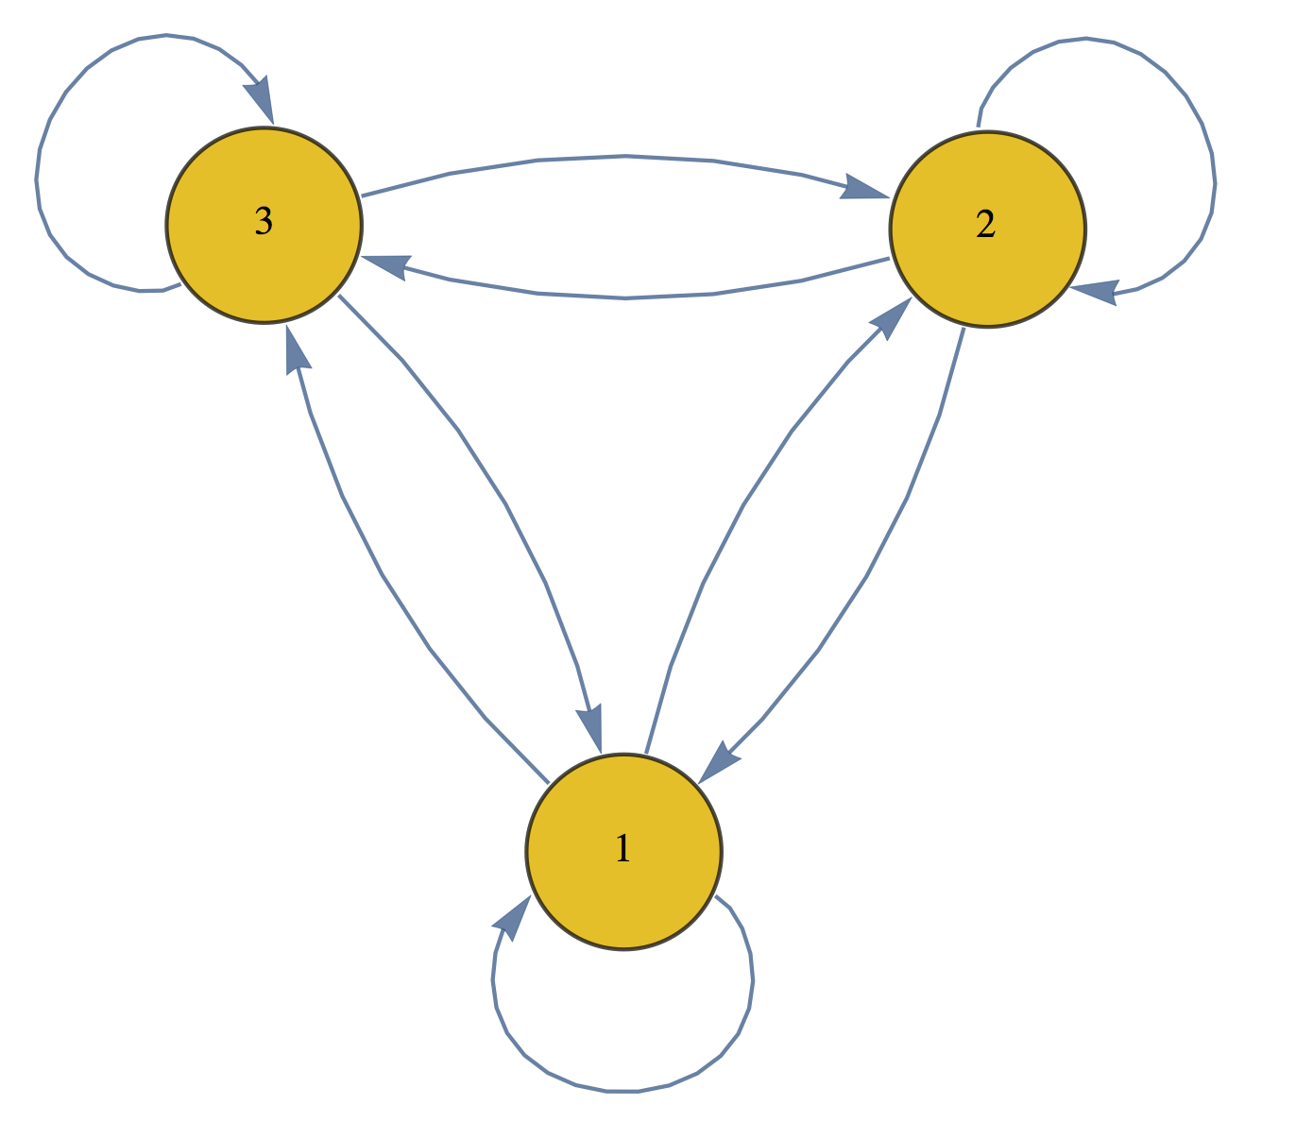
Markov Chain :

Slide 4
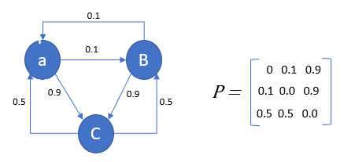
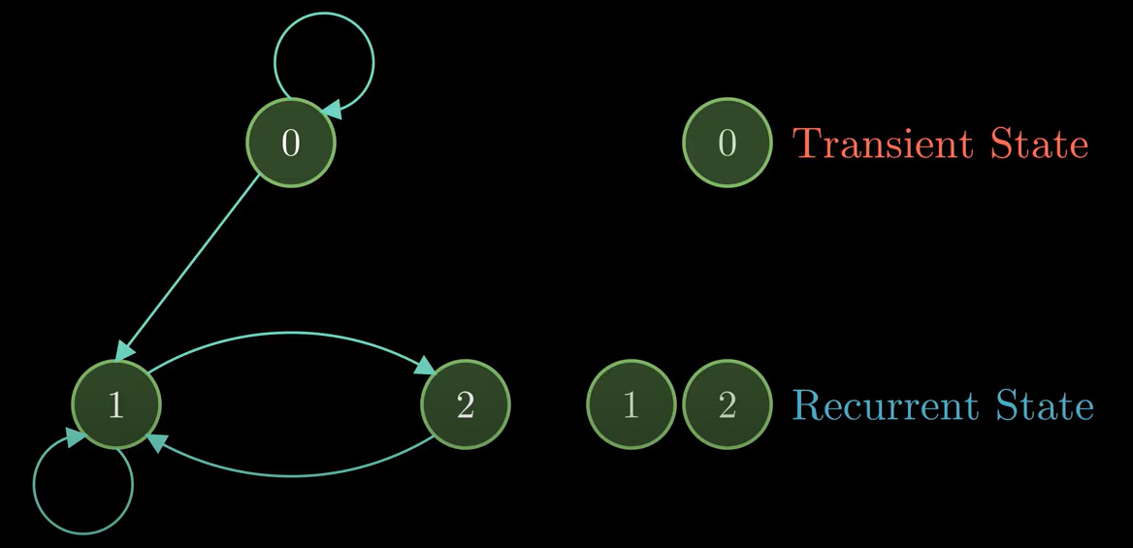
Markov chain in transition matrix form
what is “Transient State” & “Recurrent State”?

Slide 5
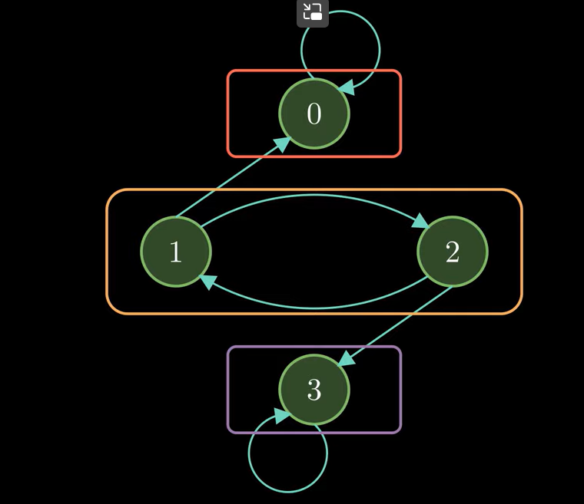
Classes in Markov chain
Hence we have three classes
Class 1 = {0}
Class 2 = {1,2}
Class 3 = {3}

Slide 6
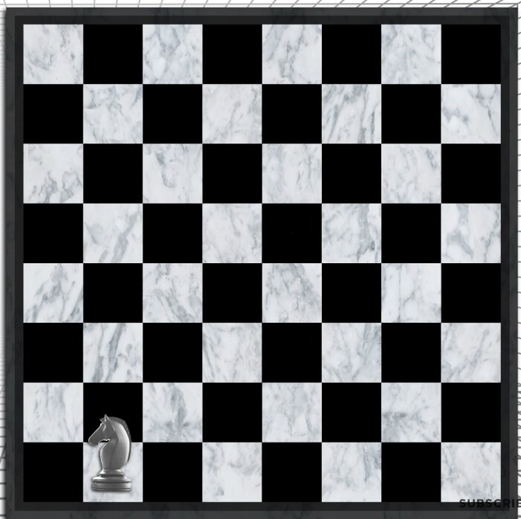
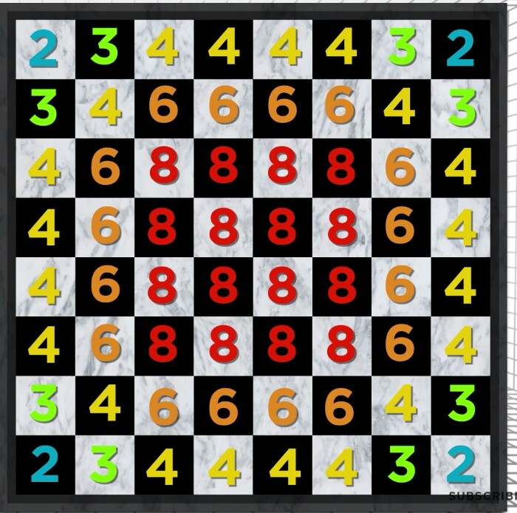
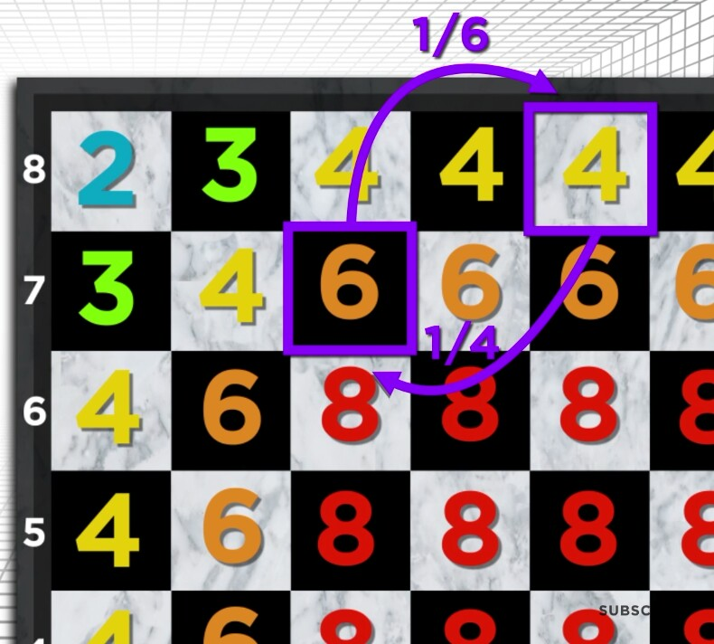
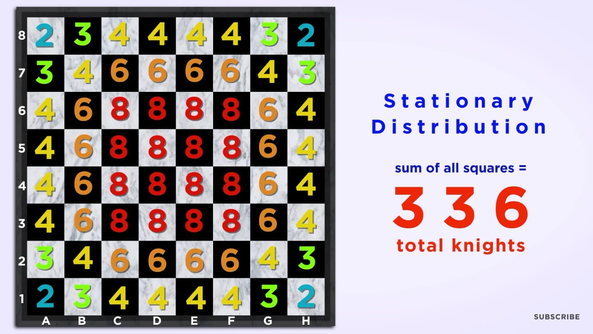
Markov chain used in the chessboard
Possibilities of the knight to move from each block in the chessboard

Slide 7
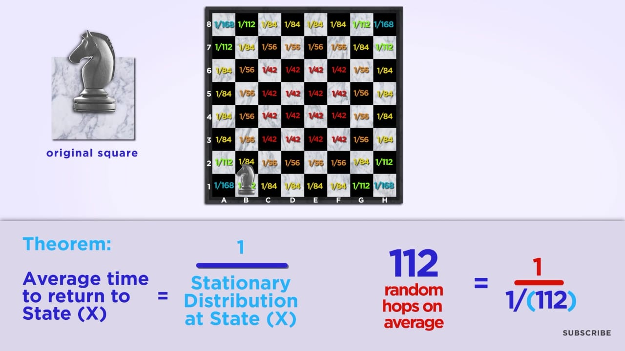
Stationary distribution & random average hopes

Slide 8
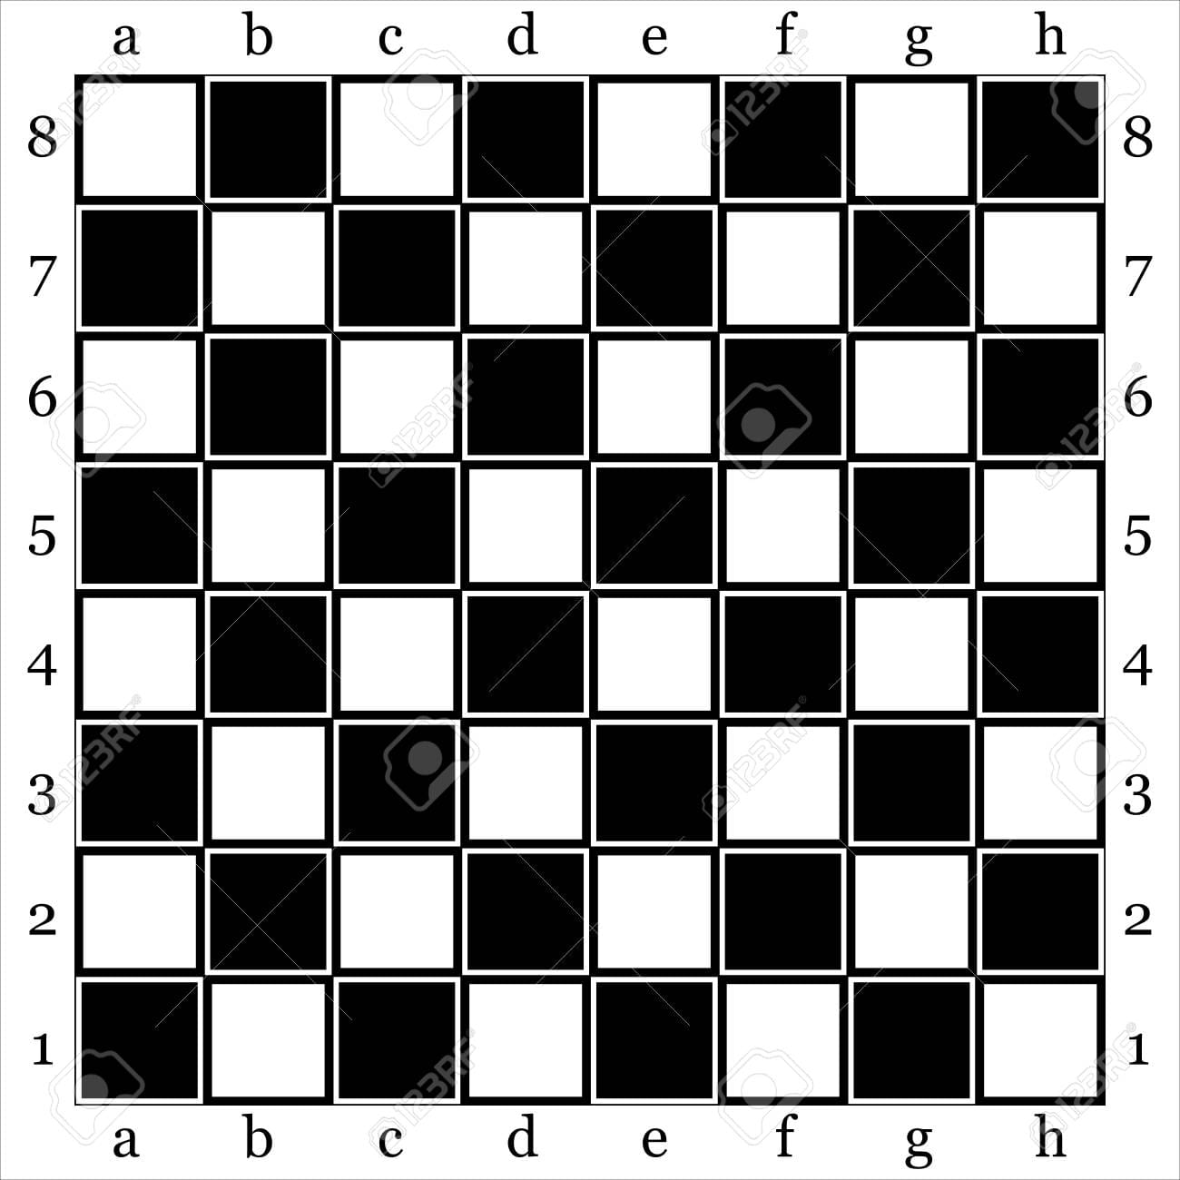
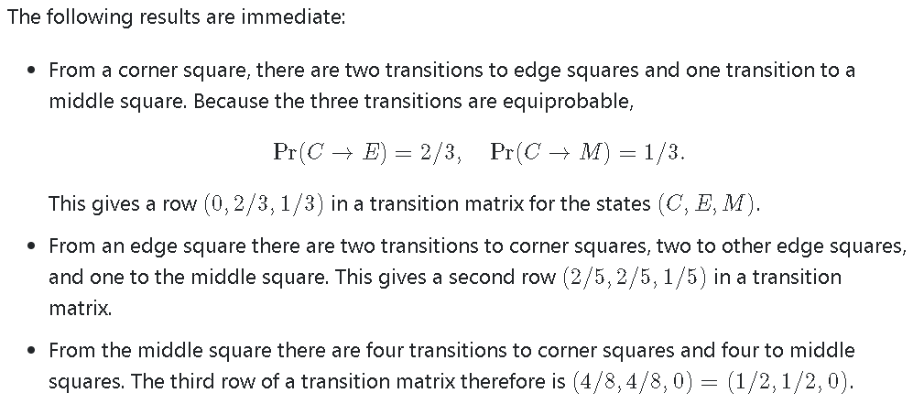
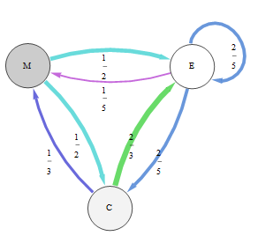
Each king can be in one of three "states":
Corner square (C)
Edge square (E)
Central ("middle") square (M).

Slide 9
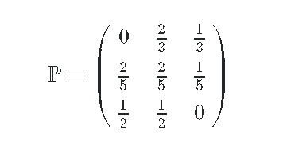
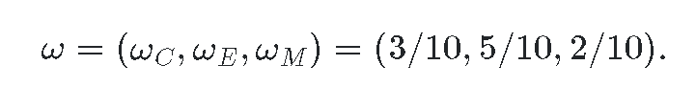
By inspection or otherwise, we find that its transition matrix
is ω=(3,5,2)′. This claim is easily checked by performing the multiplication: ωP=1ω
The eigenvalue manifestly is 1. Because all states are connected, ω gives the limiting probabilities of each king being in each state; we only need to rescale its components to sum to unity:

Slide 10
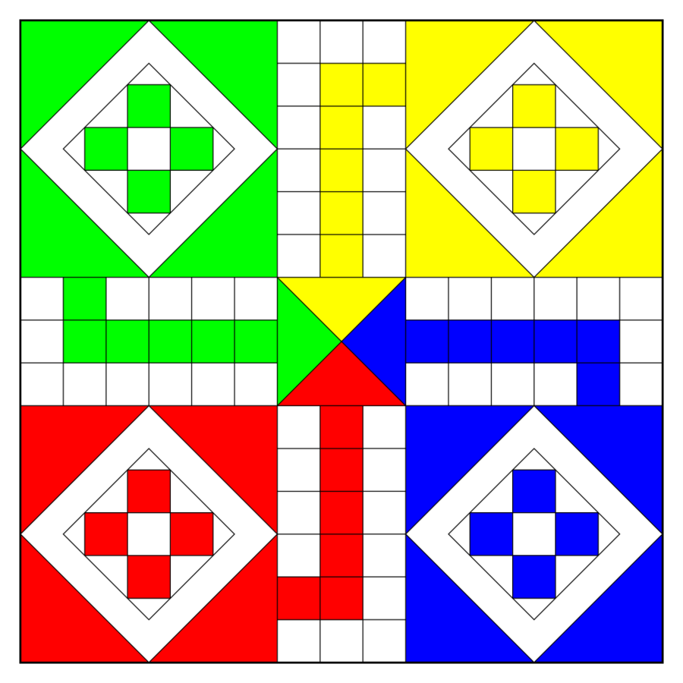
Ludo as a Markov Chain
The board game of Ludo can be modeled as a first order Markov Chain as it is “memoryless”.

Slide 11
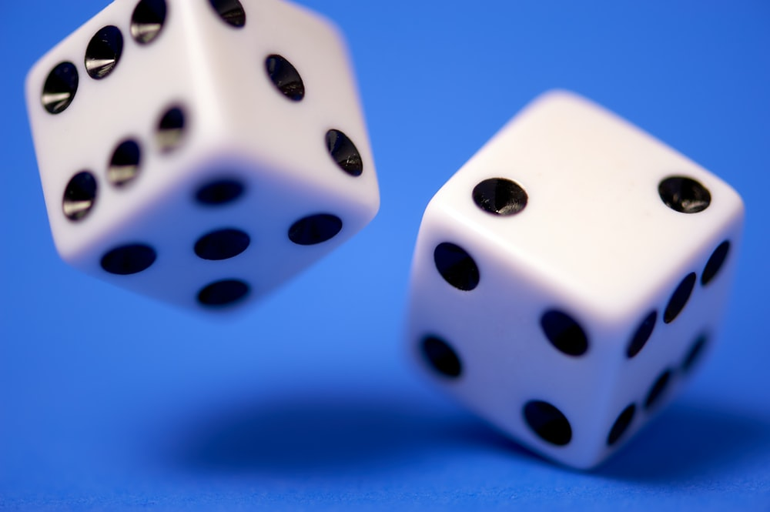
Assumptions:
There’s one player. Simplifies things greatly.
There’s only one piece.
Rolling a One moves the piece out of the yard onto the track.

Slide 12
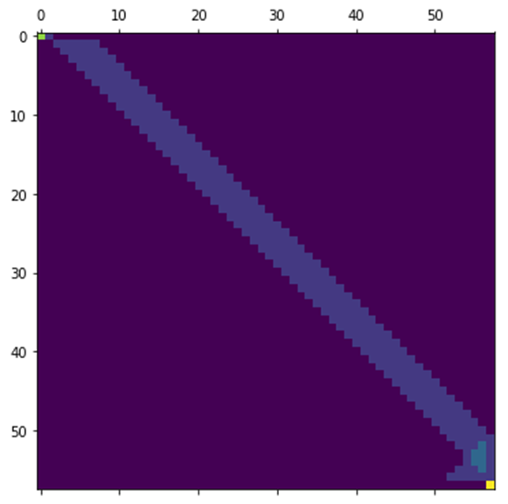
The transition matrix
Here, we have 58 states (56 cells on the track and one each for the yard and the finish state).
Matrix
created
in python:

Slide 13
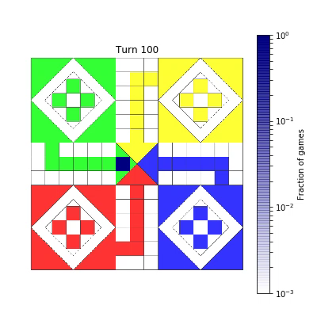

Here’s how it ends up.
moves[probs > 0][0]
11
moves[probs > 0.99][0]
52
Given our construct of the game this is obvious. One move to get on the track and then 10 moves to cover the next 57 steps (say 9 sixes and a three).
52 moves in and
still not finished?
Really unlucky.
Quickest finish

Slide 14
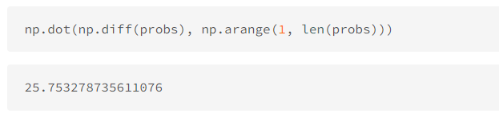
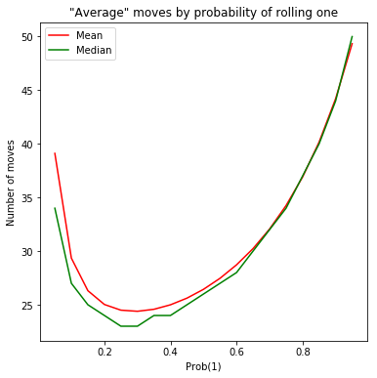
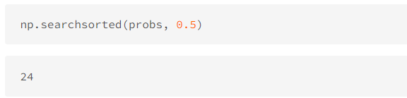
Mean
On average, the game ends in ~26 moves.
Median
So, approximately 50% of the games will be finished in fewer than 24 moves, 50% will be finished in more than 24 moves.

Slide 15
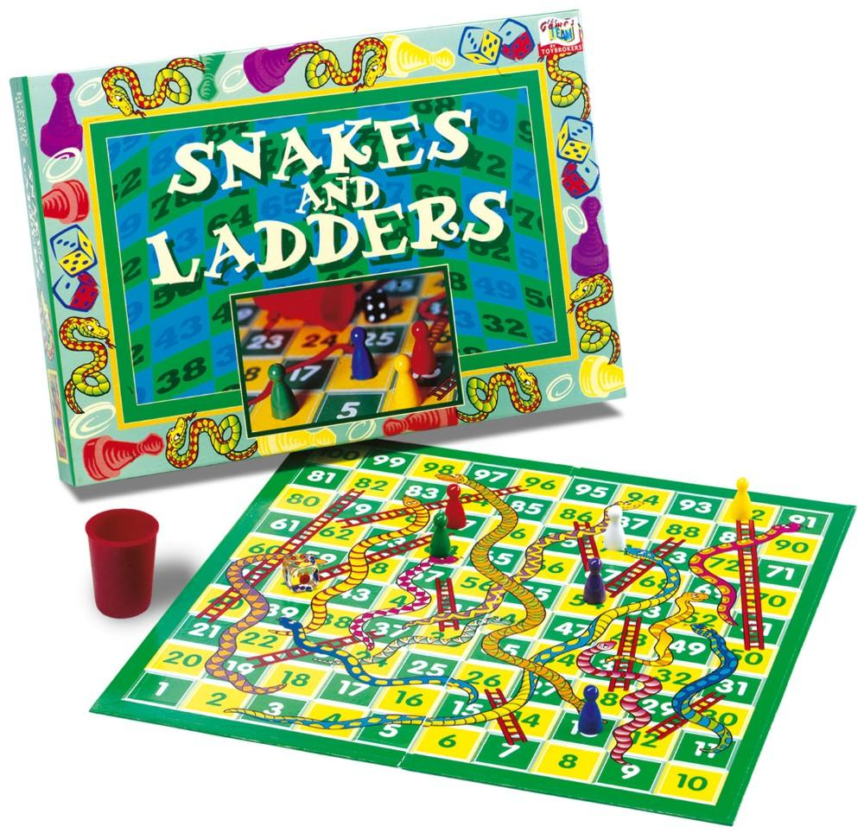
Snakes and Ladders in Markov Chain
The game of Snakes and Ladders is a good candidate for analysis with a Markov Chain because of its memorylessness: at a given point in the game, the player's progression from the current square is independent of how they arrived at that square.
This Photo by Unknown Author is licensed under CC BY-SA

Slide 16
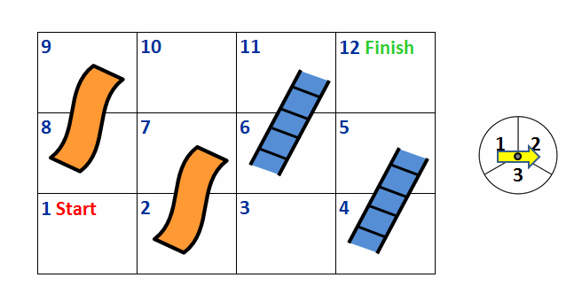
Rules of the Game:
A player starts at the red “Start” square and finishes at the green “Finish” square. A player advances along the board by spinning a spinner that results in moving forward one to three squares.
If a player ends his turn on a Ladder he immediately moves upwards along the ladder. For example, if a player ends his turn on square 6, he would immediately move to square 11.
If a player ends his turn on a snake he immediately moves down the slide. For example, if a player ends his turn on square 7, he would automatically move to square 2.
A player wins the game when he lands on or passes the Finish square.
Question: What is the average number of turns needed to finish the game?

Slide 17
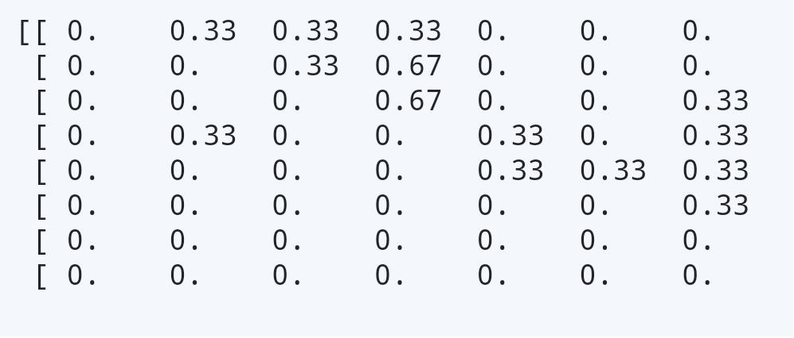
For instance, when we start at the first box of the game, the spinner gives us the following transition probabilities:
1/3 chance of moving to box 2.
1/3 chance of moving to box 3.
1/3 chance of moving to box 4, immediately taking the ladder, and ending in box 5.
0 chance of ending up in any other state.
one thing becomes immediately obvious — you can never end up in a state which is the beginning of a snake or ladder.
Let us make an 8X8 matrix P representing all of the possible transitions, where the element Pij represents the probability from moving from state i to state j.

Slide 18
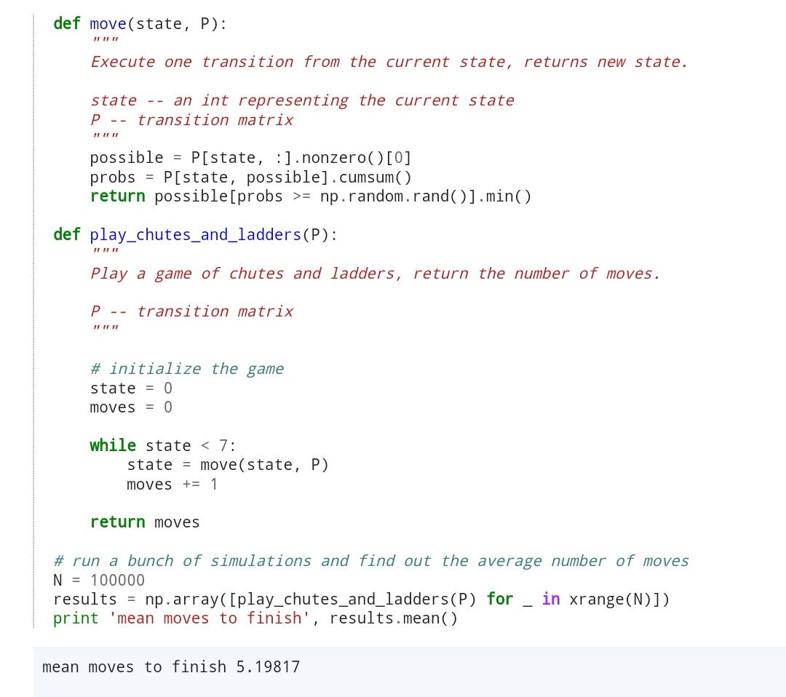
SIMULATING
We simulate many runs through the game and see empirically how many moves it took to finish. Here's a function that simulates playing the game:
So on average it takes about 5 moves to get from the starting state to finishing the game.

Slide 19
Markov Chain in Sports
For example, if you can predict what type of ball will be bowled by a bowler or shot played by a batsman. It will add up better insights for a player, a manager or a coach in context with tactical and technical aspects.
The objective of using the Markov chain model is to provide tactile or technical advice in cricket and basketball.
A Markov Reward Process (MRP) is a Markov model where transitions may have an associated reward or cost. Specifically, an MRP is a tuple (S, P, R, γ) where S is the set of states, P: S × S → [0, 1] is the transition function, R: S × S → R is a reward function associated with every transition and γ ∈ [0, 1] is a discount factor.

Slide 20
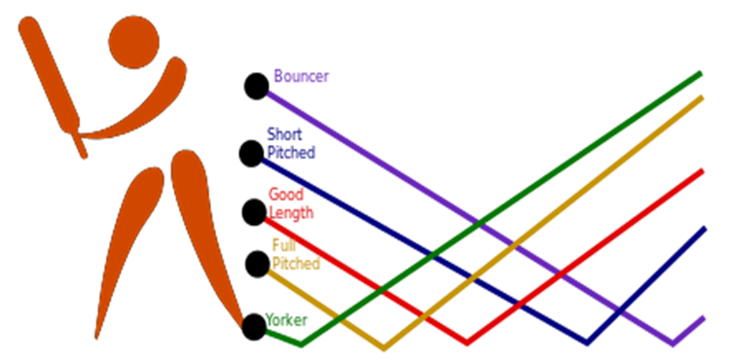
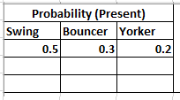
Cricket
Suppose a bowler is bowling an over if in current over he bowled 3 Swing bowl, 2 bouncer and 1 yorker then present probability will be as stated below:
If you made a Markov chain model of fast bowler’s pitching the ball, you might include “swing”, “bouncer”, “yorker,” and “over-pitched” as states, which together with another pitching could form a ‘state space’: a list of all possible states. In addition, on top of the state space, a Markov chain tells you the probabilities of hopping, or “transitioning,” from one state to any other state — -e.g., the chance that a bowler currently bouncing the ball will bowl yorker in the next 2 deliveries without overpitching first.

Slide 21
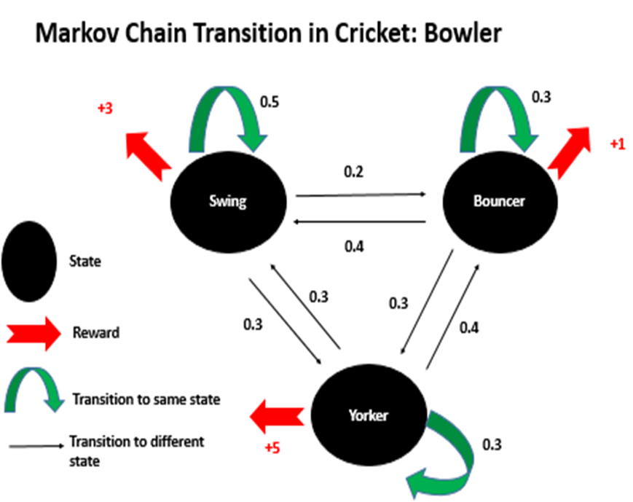
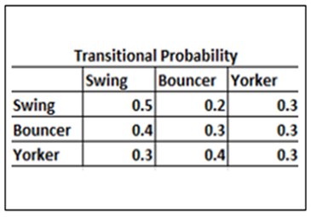

Slide 22
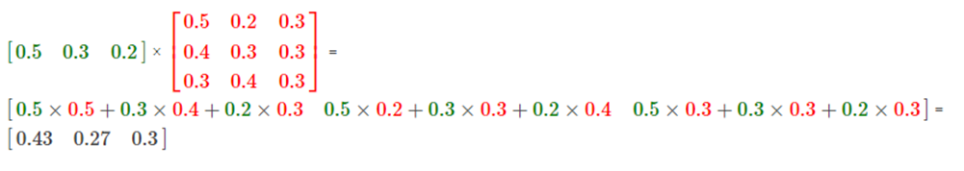
The probability of bowling next delivery as swing = 43%
The probability of bowling next delivery as bouncer = 27%
The probability of bowling next delivery as yorker = 30%
These probabilities are of one cycle of action, for the context of this discussion it could be ball by ball analysis. Similarly, the most valuable bowler can also be selected through rewards such as if a bowler is bowling yorker reward of +5 points can be awarded and so on.

Slide 23
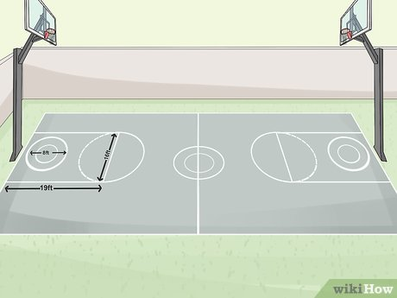
Basketball

Slide 24
Modelling Basketball Game
Example:-
Consider a basket ball player and the probability of next shot going in the basket depends upon past two shots
0: Hit in the first two shots
1: No Hit in the first shot and Hit in the second shot
2: Hit in the first shot and Hit in the second shot
3: No Hit in both of the shots

Slide 25
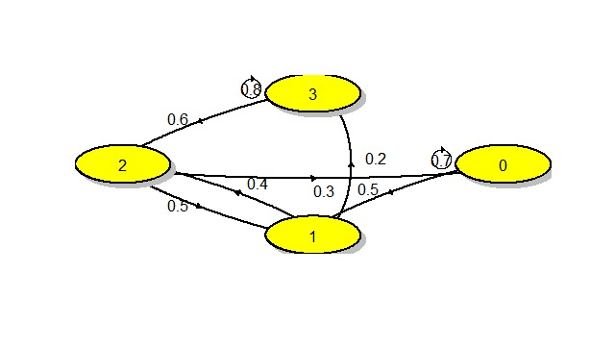
Transition Probablity Matrix
P =
 | 0 | 1 | 2 | 3
0 | 0.7 | 0 | 0.3 | 0
1 | 0.5 | 0 | 0.5 | 0
2 | 0 | 0.4 | 0 | 0.6
3 | 0 | 0.2 | 0 | 0.8

Slide 26
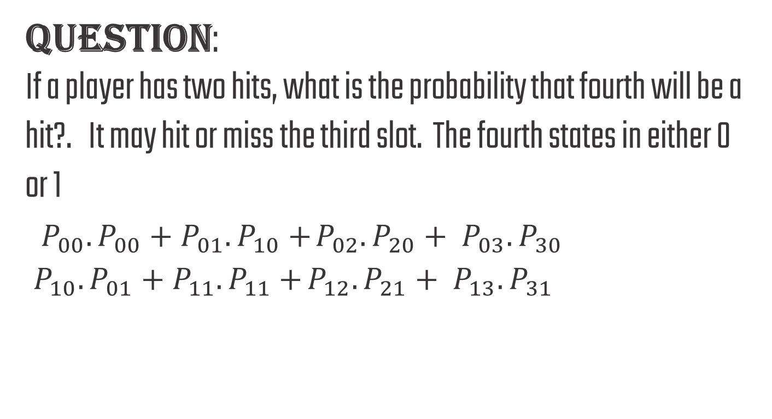
QUESTION: If a player has two hits, what is the probability that fourth will be a hit?. It may hit or miss the third slot. The fourth states in either 0 or 1 $P_{00}.P_{00}+P_{01}.P_{10}+$ $P_{02}.P_{20}+ P_{03}.P_{30}$ $P_{10}.P_{01}+P_{11}.P_{11}+$ $P_{12}.P_{21}+ P_{13}.P_{31}$

Slide 27
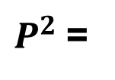
 | 0 | 1 | 2 | 3
0 | 0.49 | 0.12 | 0.21 | 0.18
1 | 0.35 | 0.20 | 0.15 | 0.30
2 | 0.20 | 0.12 | 0.20 | 0.48
3 | 0.10 | 0.16 | 0.10 | 0.64
$P^{2}$=
Required Probablity = 0.49 + 0.12
= 0.61

Slide 28
Thank you

